Slide 1
OSI MODEL
Texas College of Management & IT
BIT 4th Semester
Saroj Dhital
2nd JUNE, 2019

Slide 2
DEFINITION
OSI stands for Open System Interconnection is a reference model that describes how information from a software application in one computer moves through a physical medium to the software application in another computer.
OSI consists of seven layers, and each layer performs a particular network function.
OSI model was developed by the International Organization for Standardization (ISO) in 1984, and it is now considered as an architectural model for the inter-computer communications.
OSI model divides the whole task into seven smaller and manageable tasks. Each layer is assigned a particular task.
Each layer is self-contained, so that task assigned to each layer can be performed independently.

Slide 3
Principles of OSI Reference Model
The OSI reference model has 7 layers. The principles that were applied to arrive at the seven layers can be briefly summarized as follows:
A layer should be created where a different abstraction is needed.
Each layer should perform a well-defined function.
The function of each layer should be chosen with an eye toward defining internationally standardized protocols.
The layer boundaries should be chosen to minimize the information flow across the interfaces.
The number of layers should be large enough that distinct functions need not be thrown together in the same layer out of necessity and small enough that architecture does not become unwieldly.

Slide 4
Feature of OSI Model
Big picture of communication over network is understandable through this OSI model.
We see how hardware and software work together.
We can understand new technologies as they are developed.
Troubleshooting is easier by separate networks.
Can be used to compare basic functional relationships on different networks.

Slide 5
Characteristics of OSI Model
The OSI model is divided into two layers: upper layers and lower layers.
The upper layer of the OSI model mainly deals with the application related issues, and they are implemented only in the software. The application layer is closest to the end user. Both the end user and the application layer interact with the software applications. An upper layer refers to the layer just above another layer.
The lower layer of the OSI model deals with the data transport issues. The data link layer and the physical layer are implemented in hardware and software. The physical layer is the lowest layer of the OSI model and is closest to the physical medium. The physical layer is mainly responsible for placing the information on the physical medium.

Slide 6

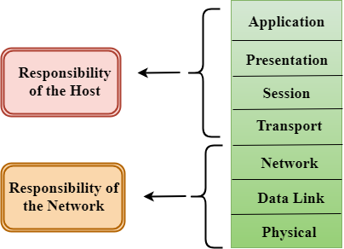

Slide 7
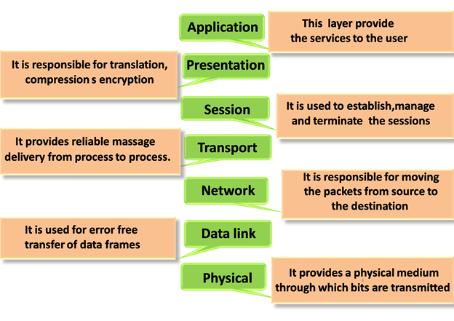
Functions of the OSI Layers

Slide 8
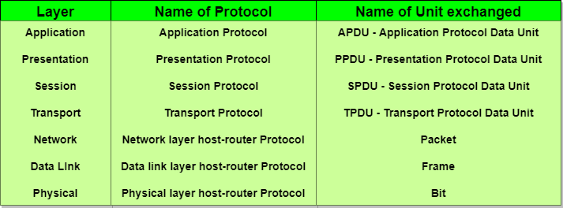

Slide 9
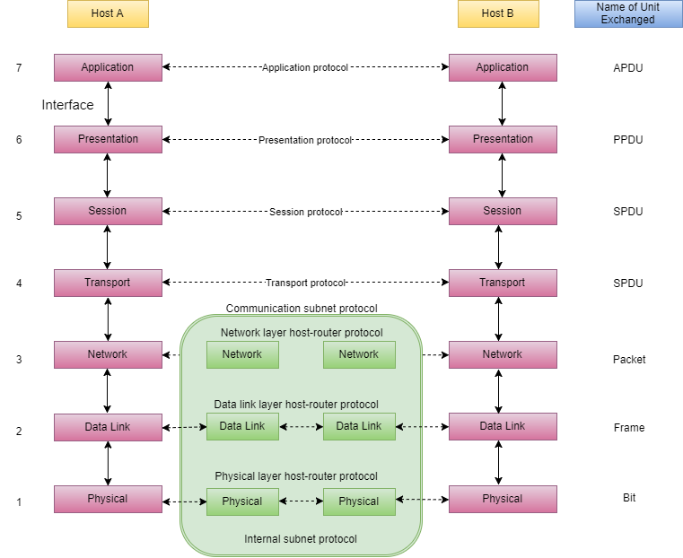

Slide 10
Merits of OSI reference model
OSI model distinguishes well between the services, interfaces and protocols.
Protocols of OSI model are very well hidden.
Protocols can be replaced by new protocols as technology changes.
Supports connection oriented services as well as connectionless service.

Slide 11
Demerits of OSI reference model
Model was devised before the invention of protocols.
Fitting of protocols is tedious task.
It is just used as a reference model.

